Slide 1

Learning Python with Hawkar
2
Week 2
2024.10
www.habdulhaq.com

Slide 2
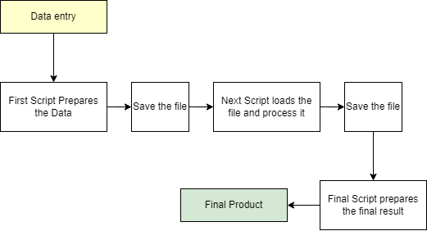
Introduction to Hawkar's Workflow
1
Hawkar's Workflow is a structured approach to breaking down complex Python projects into manageable, actionable steps.
This workflow ensures steady progress toward achieving a big goal by tackling small, achievable tasks.

Slide 3

Step 1 – Defining the Highest Goal
2
Key Concept:
Start by clearly defining the ultimate objective of the project. This will guide the entire development process.

Slide 4
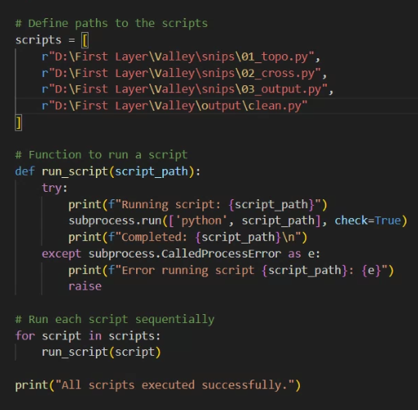
Step 2 – Breaking Down the Project into Smaller Steps
3
Key Concept:
Break down the larger project into multiple small steps that can be executed one at a time.

Slide 5
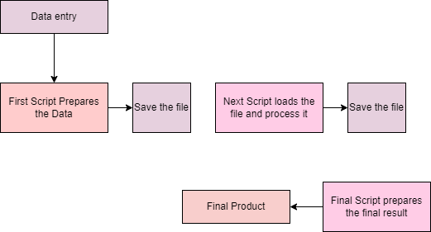
Step 3 – Execute Each Step in Phases
4
Key Concept:
Complete each phase one by one, ensuring that every individual step works properly before moving to the next. This incremental approach keeps the project organized.

Slide 6
Final – Bridging the Steps
5
Once each step is functional, connect them to work collaboratively, ensuring the flow of data and processes between the steps.

Slide 7
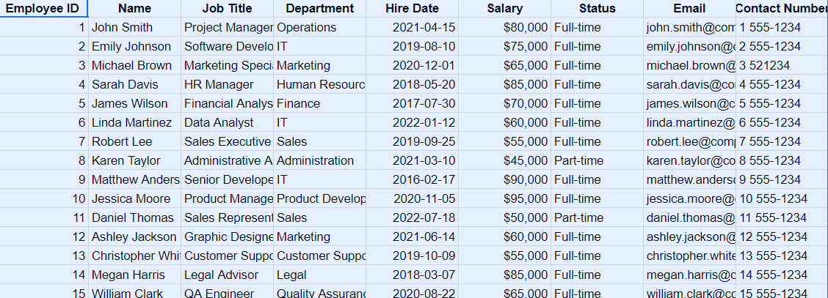
Data
6

Slide 8
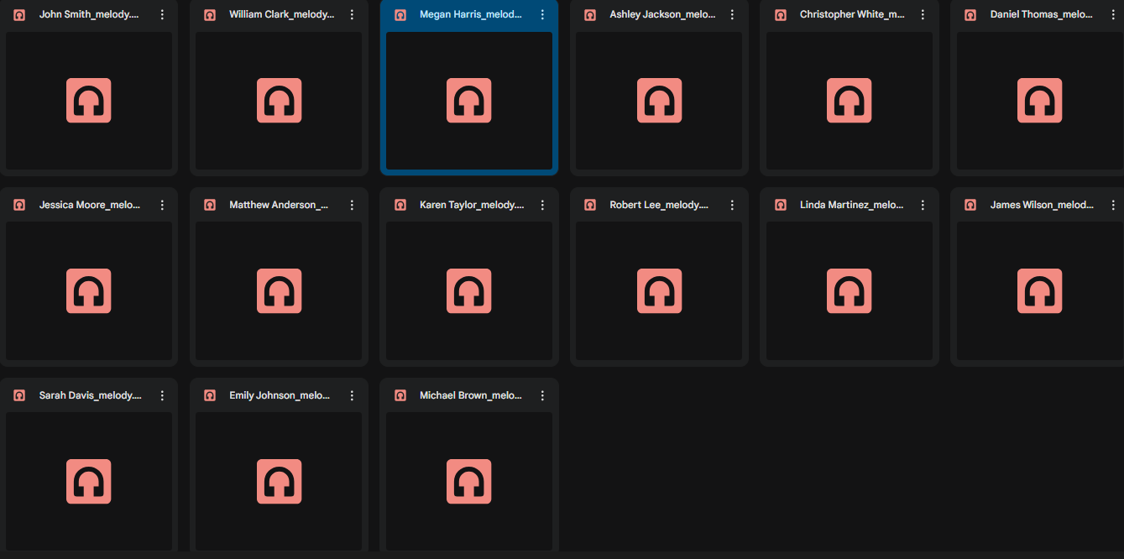

Music
7

Slide 9
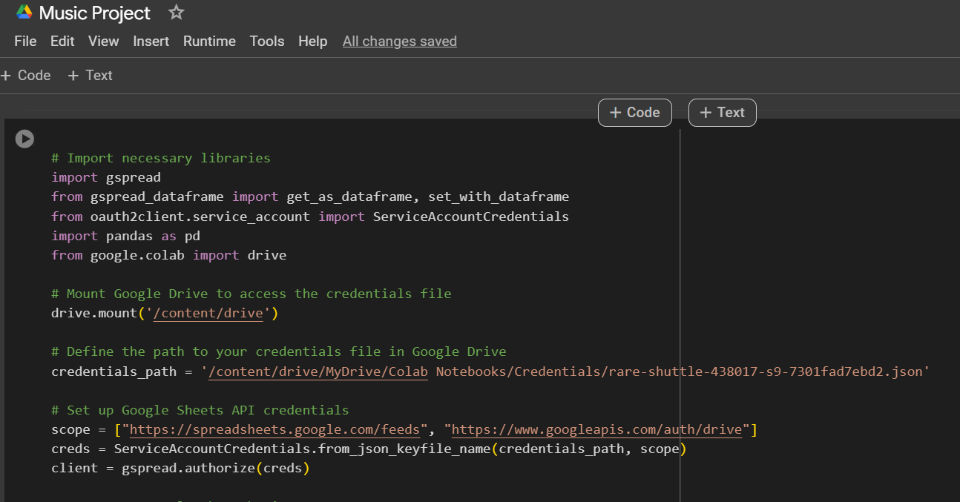
Script Example: Raw
8
Music Project
https://colab.research.google.com/drive/18Vh84js_SSQvDEn9hCIuql05hoGLK9JF?usp=sharing

Slide 10
Script Example: Connected
9
Music Master
https://colab.research.google.com/drive/10JNUnkbLJGU6LedLuTjpP4NtXOii-lKE?usp=sharing

Slide 11
How to Transform a Script into a Function
10
Why Use Functions?
Encapsulating scripts into functions improves modularity and reusability.
Functions allow you to pass parameters, making your code more flexible.
Steps:
Identify Purpose: What does the script do?
Parameterize: Replace hard-coded values with function parameters.
Encapsulate: Wrap the script inside a function using def function_name().
def add_numbers(a, b):
return a + b
ChatGPT
Please transform the following script into a Python function. The function should accept the necessary input values as parameters and return the output.
Transform the script to a function that accepts parameters for [specific task], ensuring the function does [describe task], and returns [expected result].

Slide 12
Running Multiple Functions Sequentially
11
Why Use a Master Function?
Simplifies complex workflows by triggering multiple tasks in sequence.
Organizes your process into manageable steps.
Steps:
Identify Functions: List the small tasks (functions) you need to run.
Order of Execution: Create a master function to call each function in sequence.
Create a master function that calls function1(), function2(), and function3() sequentially. Add print statements to indicate progress between steps, and include a final confirmation message.
def run_all_steps():
process_data()
generate_midi()
convert_to_wav()

Slide 13
Benefits of Modularity and Orchestration
12
Modularity:
Each script becomes a self-contained unit.
Easier to test, debug, and maintain.
Orchestration:
Complex processes are broken into manageable steps.
Enhances the ability to modify or add steps without affecting other parts of the process.
Application:
Think of breaking down tasks like data processing, file generation, and conversion into separate functions. This keeps the code organized and clear.

Slide 14
Thanks for learning with me

